Slide 1

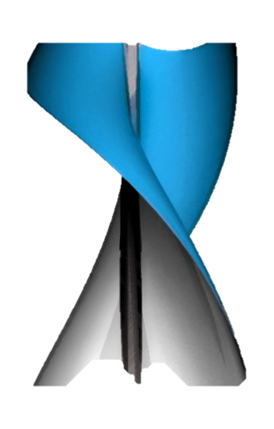



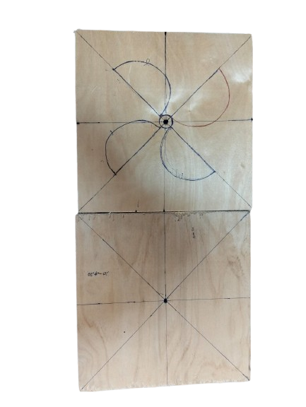

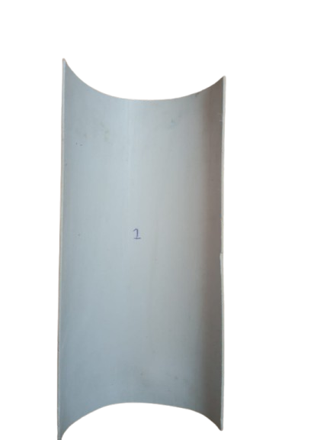
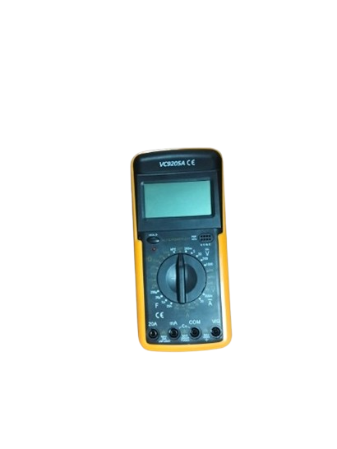



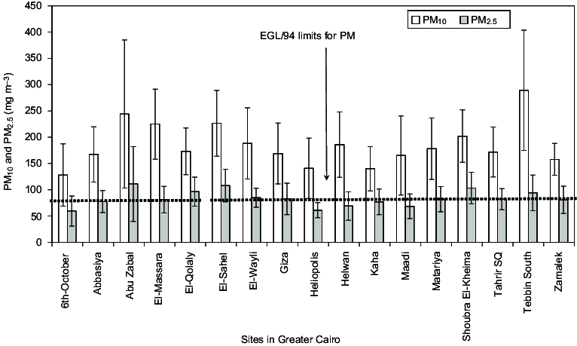
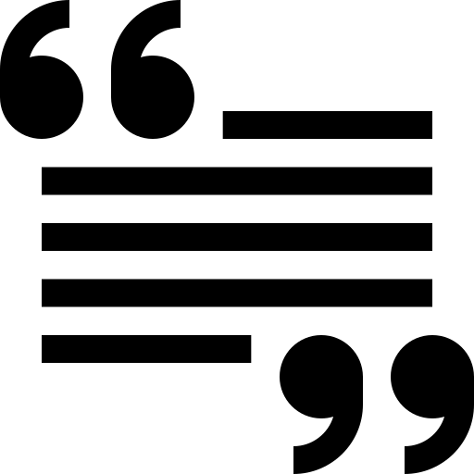



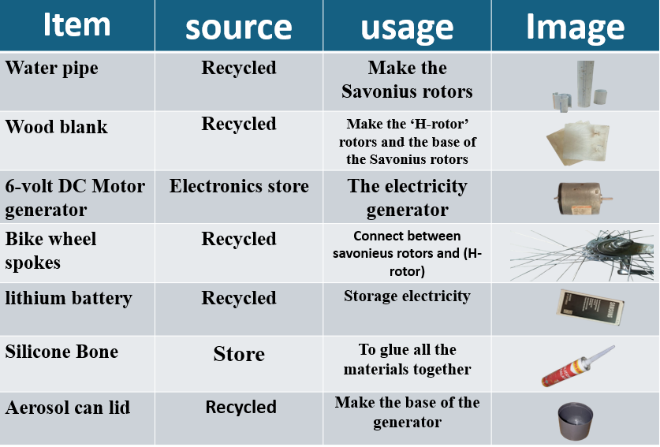

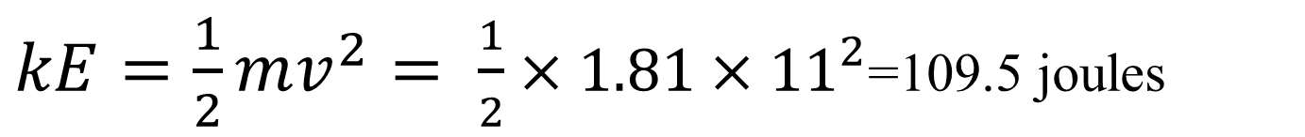

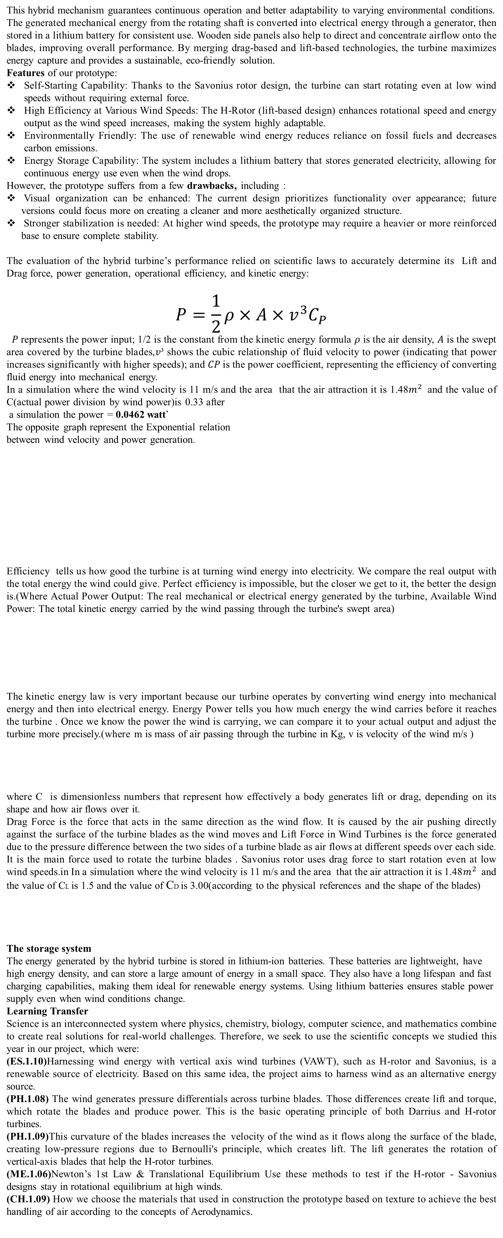
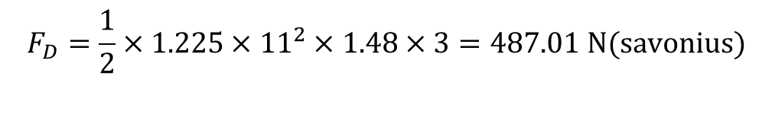


H-rotor – Savenios VAWT (Emad Ahmed - Ahmed Hassan - Mohamed Shawky – Philopateer Nabil - Ahmed Ali)
Qena STEM High School, Grade 10, 2nd semester, 2024/2025, Group no. (23110)
Key words:(Climate change - Renewable Energy - Vertical Axis wind turbine - Hybrid Wind Turbine - Aerodynamics)
Abstract
Methods
This hybrid mechanism guarantees continuous operation and better adaptability to varying environmental conditions.
The generated mechanical energy from the rotating shaft is converted into electrical energy through a generator, then stored in a lithium battery for consistent use. Wooden side panels also help to direct and concentrate airflow onto the blades, improving overall performance. By merging drag-based and lift-based technologies, the turbine maximizes energy capture and provides a sustainable, eco-friendly solution.
Features of our prototype:
Self-Starting Capability: Thanks to the Savonius rotor design, the turbine can start rotating even at low wind speeds without requiring external force.
High Efficiency at Various Wind Speeds: The H-Rotor (lift-based design) enhances rotational speed and energy output as the wind speed increases, making the system highly adaptable.
Environmentally Friendly: The use of renewable wind energy reduces reliance on fossil fuels and decreases carbon emissions.
Energy Storage Capability: The system includes a lithium battery that stores generated electricity, allowing for continuous energy use even when the wind drops.
However, the prototype suffers from a few drawbacks, including :
Visual organization can be enhanced: The current design prioritizes functionality over appearance; future versions could focus more on creating a cleaner and more aesthetically organized structure.
Stronger stabilization is needed: At higher wind speeds, the prototype may require a heavier or more reinforced base to ensure complete stability.
The evaluation of the hybrid turbine’s performance relied on scientific laws to accurately determine its Lift and Drag force, power generation, operational efficiency, and kinetic energy:
$$P=\frac{1}{2}ρ×A×v^{3}C_{P}$$
𝑃 represents the power input; 1/2 is the constant from the kinetic energy formula 𝜌 is the air density, 𝐴 is the swept area covered by the turbine blades,𝑣³ shows the cubic relationship of fluid velocity to power (indicating that power increases significantly with higher speeds); and 𝐶𝑃 is the power coefficient, representing the efficiency of converting fluid energy into mechanical energy.
In a simulation where the wind velocity is 11 m/s and the area that the air attraction it is 1.48$m^{2}$ and the value of C(actual power division by wind power)is 0.33 after
a simulation the power = 0.0462 watt`
The opposite graph represent the Exponential relation
between wind velocity and power generation.
Efficiency tells us how good the turbine is at turning wind energy into electricity. We compare the real output with the total energy the wind could give. Perfect efficiency is impossible, but the closer we get to it, the better the design is.(Where Actual Power Output: The real mechanical or electrical energy generated by the turbine, Available Wind Power: The total kinetic energy carried by the wind passing through the turbine's swept area)
The kinetic energy law is very important because our turbine operates by converting wind energy into mechanical energy and then into electrical energy. Energy Power tells you how much energy the wind carries before it reaches the turbine . Once we know the power the wind is carrying, we can compare it to your actual output and adjust the turbine more precisely.(where m is mass of air passing through the turbine in Kg, v is velocity of the wind m/s )
where C is dimensionless numbers that represent how effectively a body generates lift or drag, depending on its shape and how air flows over it.
Drag Force is the force that acts in the same direction as the wind flow. It is caused by the air pushing directly against the surface of the turbine blades as the wind moves and Lift Force in Wind Turbines is the force generated due to the pressure difference between the two sides of a turbine blade as air flows at different speeds over each side. It is the main force used to rotate the turbine blades . Savonius rotor uses drag force to start rotation even at low wind speeds.in In a simulation where the wind velocity is 11 m/s and the area that the air attraction it is 1.48$m^{2}$ and the value of CL is 1.5 and the value of CD is 3.00)according to the physical references and the shape of the blades)
The storage system
The energy generated by the hybrid turbine is stored in lithium-ion batteries. These batteries are lightweight, have high energy density, and can store a large amount of energy in a small space. They also have a long lifespan and fast charging capabilities, making them ideal for renewable energy systems. Using lithium batteries ensures stable power supply even when wind conditions change.
Learning Transfer
Science is an interconnected system where physics, chemistry, biology, computer science, and mathematics combine to create real solutions for real-world challenges. Therefore, we seek to use the scientific concepts we studied this year in our project, which were:
(ES.1.10)Harnessing wind energy with vertical axis wind turbines (VAWT), such as H-rotor and Savonius, is a renewable source of electricity. Based on this same idea, the project aims to harness wind as an alternative energy source.
(PH.1.08) The wind generates pressure differentials across turbine blades. Those differences create lift and torque, which rotate the blades and produce power. This is the basic operating principle of both Darrius and H-rotor turbines.
(PH.1.09)This curvature of the blades increases the velocity of the wind as it flows along the surface of the blade, creating low-pressure regions due to Bernoulli's principle, which creates lift. The lift generates the rotation of vertical-axis blades that help the H-rotor turbines.
(ME.1.06)Newton’s 1st Law & Translational Equilibrium Use these methods to test if the H-rotor - Savonius designs stay in rotational equilibrium at high winds.
(CH.1.09) How we choose the materials that used in construction the prototype based on texture to achieve the best handling of air according to the concepts of Aerodynamics.
Conclusion
Currently, Egypt is facing many challenges that are slowing down its progress and development. One of the most consequential and crucial of these problems is climate change, which is mainly caused by using environmentally polluting energy sources. Therefore, we tried to find a solution to these issues. Along the way, we faced other challenges facing Egypt, such as pollution and the lack of available job opportunities.
All these problems are interconnected, and the best solution to address them is to find a sustainable, non-polluting energy source. We found that the best solution is to design a wind turbine that combines two systems: Savonius and H-rotor (Savonius-H-rotor hybrid wind turbine), making it capable of operating efficiently in various environments. Efficiency tells us how good the turbine turns wind energy into electricity. We compare the real output with the total energy the wind could give. Perfect efficiency is impossible, but the closer we get to it, the better the design is, and total efficiency is 41.99%. The implementation of this project will be simple and fully based on recycled materials, which facilitates its realization. We used parts of previously recycled plastic pipes to build the Savonius turbine structure, and strong wooden panels to create the external structure of the H-rotor turbine. This type of project requires high precision in choosing the right materials and taking accurate measurements to ensure it is implemented correctly.
The construction of the prototype occurred in the
subsequent manner:-
Determine the texture and the dimensions of
The materials (wood, blanch_ water pipes) and buying them.
Cutting the water pipes to make the structure of the Savonius rotors.
Cutting the wood blank to make the base of the Savonius and market the wood base to determine the right place of the Savonius rotors.
Cutting the wood blank to make the structure of the (H-rotor) rotors.
Cutting the wood blank to make the base of the prototype.
Attaching the generator to the base.
Test plan:-
Adhering to safety protocols by wearing safety equipment.
Experiment with the prototype output (40 joules or less) at the specific time.
Use a multimeter to measure volts and amperes and a stopwatch to measure the time.
Use a law to measure joules in seconds.
Repeating the test multiple times.
Noting down the results of the test.
We therefore concluded that after subjecting our test data to testing, our hybrid Savonius-H-Rotor wind turbine model met all the required Capstone design specifications. It was producing consistent electric output at low winds, it met the size dimension specifications, and its main composition consisted of recycled, local, and readily accessible material. Efficiency tells us how good the turbine turns wind energy into electricity. We compare the real output with the total energy the wind could give. Perfect efficiency is impossible, but the closer we get to it, the better the design is, and total efficiency is 41.99 %. The design consisted of a very simple, trustworthy energy storage system, and its structural configuration withstood over tens of tests. Balance and function adjustments were completed after some testing. Proudly borrowing lessons from the experience of traditional vertical-axis wind turbines, our design boasts the good self-starting characteristic of the Savonius rotor and the high-speed efficiency of the H-Rotor. This allowed our design to function at its best in mixed conditions without requiring complex components. Compared to other single-type rotor designs before it, our hybrid was more efficient, easier to construct, and field deployable. The design is sustainable, affordable, and useful.
It shows clear improvement in usability, sustainability, and dependability, and is a good example of small-scale renewable energy technology systems. Our project uses the Capstone's focus on innovation and environmental responsibility well.
It also provided us with real hands-on experience for addressing real engineering issues, proving that clean energy can be harnessed by simple hardware, collaboration, and creative design.
(Figure 2)
Base of Savonius rotors
(Figure 3)
Savonius rotor
Introduction
As of today, Egypt is facing quite a few challenges. The most prominent of these challenges are known as the Egyptian Grand Challenges, which represent pressing issues that require creative and sustainable solutions. One of the most consequential challenges is the reliance on non-renewable energy resources. This challenge has other consequences, such as climate change and pollution.
(figure 4)
Multimeter the device that used to measure volts and ampere
Recommendation
Results
More reliance on non-renewable resources means a greater number of pollutants in the air. This is evident in crowded cities that consume large amounts of energy and have many sources of pollution, such as car exhaust (as shown in Graph 1,this graph represents the amount of PM10 and PM2.5 in some areas in Cairo). It is known that if we rely on renewable and clean energy sources, this will greatly help in reducing air pollution rates and in confronting climate change. Moreover, implementing these projects will create new job opportunities.
Negative result:-
The turbine showed unstable rotation in low wind speeds, which reduced energy output.
Blade alignment issues caused mechanical imbalance. The generator efficiency dropped due to friction in the shaft.
Positive result:- The opposite graphs and tables represent the positive result
Innovation is a continuous process, and there is always room to implement new improvements and enhancements to ensure the design keeps pace with the rapid evolution of modern technology. Some of the recommendations or modifications:
Try to use an Arduino system to have more control over our prototype.
Use a material stronger than (our material), and we suggest using this material (wood - blanch - water pipes - Part of the clothes hanger).
Try to do more safety in our project, for example, put a box near the project and put the wires in it.
Use a Voltage Regulator to have more control over the prototype. Try to use the Anemometer sensor in the project to measure wind speed.
Improving Blade Design for Better Aerodynamics.
Include a Simple Braking Mechanism.
Improving Blade Design for Better Aerodynamics.
Include a Simple Braking Mechanism.
(Figure 1)
The amount of PM10 and PM2.5 in some areas in Cairo
Time (s)\ | I (Ampere)
30 s | 0.046 ± 0.01A
60 s | 0.049 ±0.01A
90 s | 0.047 ±0.01A
120 s | 0.051 ±0.01A
150 s | 0.05 ±0.01A
180 s | 0.046 ±0.01A
210 s | 0.042 ±0.01A
240 s | 0.044 ±0.01A
270 s | 0.046 ±0.01A
300 s | 0.041 ±0.01A
Previously, many efforts have been made to solve the problems of dependence on polluting sources such as fossil fuels. However, the problem still exists and is facing Egypt.
Therefore, our capstone project focuses on studying and analyzing many of the previous methods and solutions to know the good and bad ones and innovating the best new methods to confront this problem soundly, applying the advantages of the previous projects and avoiding the disadvantages.
After evaluating many of the previous solutions, two solutions were agreed upon, which are the Sharm El-Sheikh Wind Energy Project in Egypt and the Norwegian Floating Vertical Wind Turbines.
The Sharm El-Sheikh Wind Energy Project in Egypt and Norwegian Floating Vertical Wind Turbines are two innovative concepts for generating clean, renewable electricity.
The Sharm el-Sheikh project harnesses wind power on land to reduce greenhouse gas emissions, generate jobs, and support Egypt's policy of diversifying energy supplies.
It adds energy security and improves the country's sustainable image, though at the cost of high initial investment, dependency on weather conditions, and potential impacts on nearby wildlife.
In the same way, Norway's floating vertical wind turbines are a major innovation in offshore wind, employing vertical-axis turbines on floating platforms to capture stronger, steadier offshore winds. These turbines come with advantages such as less disturbance to the environment, greater stability in deep waters, and reduced visual impacts from the shore.
They also come with challenges, however, including high construction and maintenance costs and technical challenges in balancing the floating structures.
And these don’t match our design requirements, our requirements are user-friendly. Environmentally friendly. Fast in producing energy.
Non-impediment (your device will not negatively affect the students’ activities.
Both projects show the potential and complexity of boosting renewable energy across the world.
After much research, the result was that the common and easy-to-apply solution for the previous challenges is building the wind turbines, especially the vertical ones.
This type of wind turbine is perfect for dealing with the air and spinning to generate electricity.
The proposed design of the prototype is a Savonius H-Rotor hybrid wind turbine with semi-covered sides to manage the interaction with air flow.
This hybrid can help in making the use of the H-rotor design easier because the H-tor requires a strong air flow to start moving.
The design of this hybrid makes it perfect to operate independently of wind direction, making it ideal for areas with unstable winds. Additionally, it fits into small spaces and urban environments, providing a perfect solution for urban areas or regions with limited space.
The hybrid turbine is easy to build and low-cost compared to large-scale projects like floating wind turbines or those with horizontal axes because it can be built with completely recycled materials.
$$η\frac{P_{Output}}{P_{fluid}}=$$
$$\frac{0.194}{0.462}∗100=41.99\%$$
Literature cited
(Figure 5)
Graph between Electric current intensity and Time
(Figure 6)
Table between Electric current intensity and Time
Figure 11: Exponential relation between wind velocity and power generation.
Time (s) | Potential Difference (Volts)
30 s | 4.20 ±0.01V
60 s | 4.23 ±0.01V
90 s | 4.21 ±0.01V
120 s | 4.25 ±0.01V
150 s | 4.24 ±0.01V
180 s | 4.20 ±0.01V
210 s | 4.19 ±0.01V
240 s | 4.21 ±0.01V
270 s | 4.20 ±0.01V
300 s | 4.17 ±0.01V
1- Chandler, D. L. (2024). MIT engineers' new theory could improve the design and operation of wind farms. MIT News. Massachusetts, United States. https://news.mit.edu/2024/new-theory-could-improve-design-and-operation-wind-farms-0821
2- El-Nenaey, K. M., Eldrainy, Y. A., Eissa, A. A., & Kassab, S. Z. (2020). Performance evaluation of hybrid vertical axis wind turbine. Thermal & Fluids Analysis Workshop (TFAWS). Alabama, United States. https://tfaws.nasa.gov/wp-content/uploads/TFAWS2020-ID-512-El-Nenaey-Paper.pdf
3- Giguère, P., & Selig, M. S. (2000). Blade geometry optimization for the design of wind turbine rotors. AIAA Paper No. 2000-0045. Nevada, United States.
https://m-selig.ae.Illinois.edu/pubs/GiguereSelig-2000-AIAA-2000-0045.pdf
4- U.S. Department of Energy. (2023). Wind energy basics. Office of Energy Efficiency & Renewable Energy. Washington, D.C., United States
https://www.energy.gov/eere/wind/wind-energy-basics
5- U.S. Energy Information Administration. (2024, August 13). Country analysis brief: Egypt. U.S. Department of Energy. Washington, D.C., United States. https://www.eia.gov/international/content/analysis/countries_long/Egypt/pdf/Egypt.pdf
$kE=\frac{1}{2}mv^{2}= \frac{1}{2}×1.81×{11}^{2}$=109.5 joules
(Figure 7)
Graph between Potential Difference and Time
(Figure 8)
Table between Potential Difference and Time
Energy (Joules) = Electric current Intensity (Ampere) * Potential Difference (Volts)
Time (s) | Energy(Joules)
30 s | 5.79 ± 0.01J
60 s | 11.92 ± 0.01J
90 s | 17.77 ± 0.01J
120 s | 24.17 ± 0.01J
150 s | 30.46 ± 0.01J
180 s | 36.28 ± 0.01J
210 s | 41.61 ±0.01J
240 s | 47.17 ± 0.01J
270 s | 52.94 ± 0.01J
300 s | 58.09 ± 0.01J
$$F_{l/D}=\frac{1}{2}ρ×v^{2}×A×C_{l}/D$$
(Figure 9)
Graph between Energy produced and Time
(Figure 10)
Table between Energy produced and Time
Acknowledgment
Materials
Analysis
$${ F}_{\overline{L}}=\frac{1}{2}×1.225×{11}^{2}×1.48×1.5=53.4 N (for H−rotor turbine)$$
There are numerous Grand Challenges facing Egypt, one of which is the extensive use of non-renewable sources of energy. This worsens climate change, rises in air pollution, and undermines the health of the public, particularly in densely populated cities, as shown in Graph 1. From scientific studies, a transition to renewable energy substantially reduces greenhouse emissions and improves air quality.
our project meets these issues squarely by promoting the use of clean, renewable sources of energy such as solar and wind energy. By reducing the consumption of fossil fuels, the project reduces carbon emissions, minimizes the effects of climate change, and promotes environmental sustainability. It also contributes to economic development by creating jobs in the renewable energy sector and catalyzing a shift towards a green economy. By its scientific and sustainable nature, the project suggests a practical solution for Egypt's energy and environmental issues, leading towards long-term national resilience.
To fix our negative results, we reinforced the mounting structure using tighter joints and additional support brackets from recycled aluminum parts. Blade alignment was corrected through repeated manual adjustments and angle re-checks using a protractor. To reduce vibration, we rebalanced the rotor by adjusting blade weights. Electrical issues were fixed by re-soldering loose wires and using stronger insulation tape to prevent disconnection. We shortened wire lengths between the generator and storage unit to reduce energy loss. For wind direction changes, we tested the system in a controlled position to maintain optimal facing, improving overall stability and minimizing rotation interruptions during variable wind conditions.
This project is based on a Hybrid Vertical Axis Wind Turbine (VAWT) that combines a Savonius rotor and an H-Rotor. The Savonius self-starting and reliable in weak conditions. As wind speed increases, the H-Rotor, designed with airfoil-shaped blades, generates lift force following Bernoulli’s principle, boosting rotational speed and improving efficiency.
We specifically chose to combine these two rotors because each addresses a different wind condition: the Savonius ensures early motion at low speeds, while the H-Rotor significantly enhances energy production at higher speeds.
$$F_{D}=\frac{1}{2}×1.225×{11}^{2}×1.48×3=487.01 N(savonius)$$
At the end of this exciting journey, we would like to extend our heartfelt thanks to everyone who supported and guided us throughout this project . We are especially grateful to Mr. Mohamed Mokhtar, who stepped in during a critical moment as a substitute for our General Cap mentor, providing us with exceptional support and motivation when we needed it most . We also express our deep appreciation to Mr. Mahmoud Abdallah for always being available to answer our questions and offer technical guidance with patience and clarity.
Our warm thanks go to Miss Shaimaa, our physics teacher, who played a vital role in helping us understand various electrical concepts and scientific terms, which were essential to the success of our work . Our sincere thanks go to the amazing students of Grade 11, who generously shared their experiences and stood by our side from the very beginning. Your advice and presence meant a lot to us . We also thank all the students of S27 for their strong spirit of collaboration. Throughout the project, we worked as one united team, helping and supporting each other with dedication . This project is not just the result of our work, but a reflection of the incredible school community we are proud to be part of.
For further information
Emad Ahmed Fathi Emad.2324027@stemqena.moe.edu.eg
Ahmed Hassan Ahmed.2324004@stemqena.moe.edu.eg
Mohamed Shawky Mohamed.2324049@stemqena.moe.edu.eg
Philopateer Nabil philopateer.2324039@stemqena.moe.edu.eg
Ahmed Ali Ahmed.2324006@stemqena.moe.edu.eg

